Slide 1
UNIT IV
Machine - Learning Paradigms

Slide 12
https://www.linkedin.com/posts/thomas-hoffmann-dataexpert_machinelearning-ai-robots-activity-7046193217238630401-8Bpg/

Slide 35
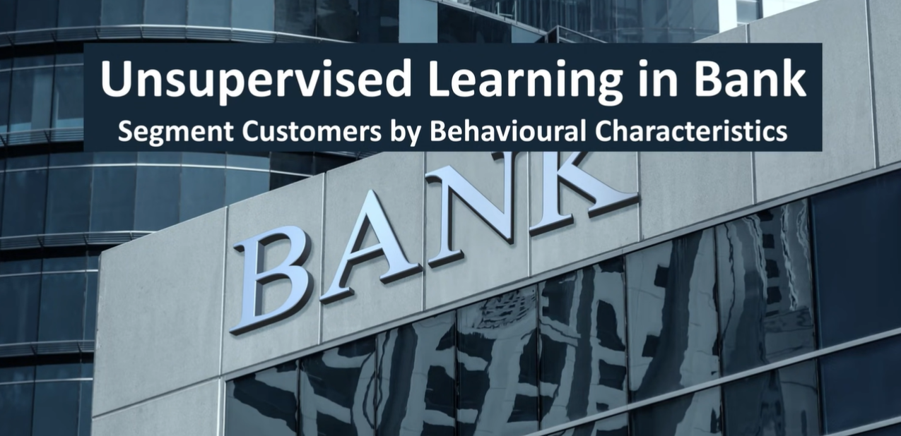

Slide 37
Is a type of specific ML algorithm that allows software agents and machines to automatically determine the ideal behavior within a specific context to maximize its performance

Slide 39
Reinforcement learning is about the interaction between two elements: the environment and the learning agent.
The learning agent leverages two mechanisms namely EXPLORATION and EXPLOITATION.
When a learning agent acts on a trial-and-error basis it is termed an exploration and when it acts based on the knowledge gained from the environment it is referred to as exploitation.
This environment rewards the agent for correct actions which is a reinforcement signal leveraging the rewards obtained, the agent improves its environment knowledge to select the next action.
In the figure, it can be observed that the machine is confused about whether it is an apple or not. Then the machine is trained using reinforcement learning. If it makes the correct decision, it gets reward points for it and in case of wrong, it gets a penalty. Once the training is done, the machine can easily identify which one of them is an apple.

Slide 40
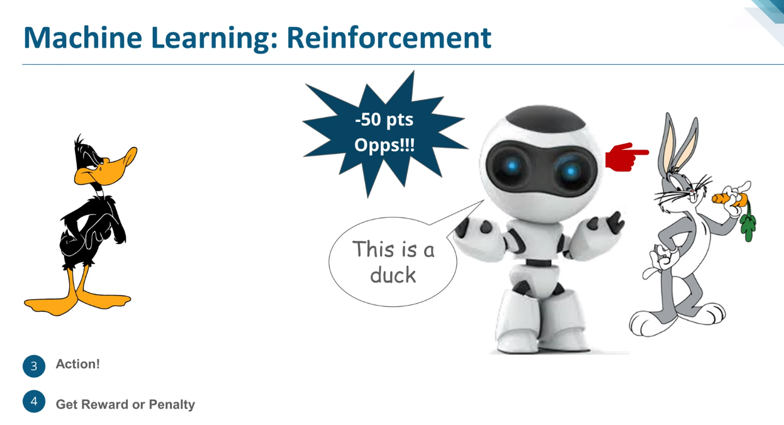

Slide 49
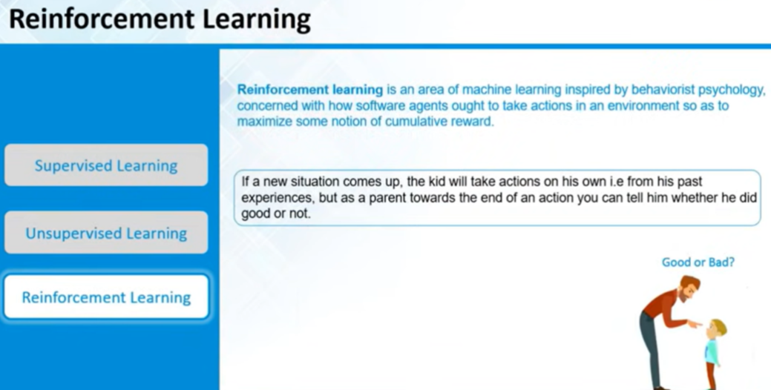

Slide 58
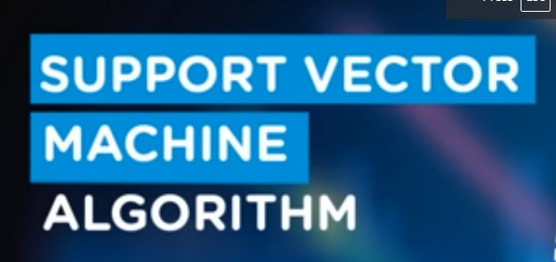
SUPERVISED LEARNING ALGORITHMS

Slide 60
Regression analysis involves graphing a line over a set of data points that most closely fits the overall shape of the data.
A regression shows the changes in the dependent variable on the y-axis to the changes in the explanatory variable on the x-axis.

Slide 61
Determining the strength of predictors
What is the relationship between sales and marketing spending?
What is the relationship between age and income?
Forecasting an effect
How much additional sales income will I get for each thousand dollars spent on marketing?
Trend forecasting
What will be the price of Bitcoin in the next six months?

Slide 62
To summarize:
The type of function we are mapping to is the main point of difference between linear and logistic regression.
The linear regression maps the continuous X to the continuous Y. On the other hand, logistic regression maps the continuous X to binary Y. Thus, we can use logistic regression to make categories in data or take true or false decisions.

Slide 64
Classification and Regression capabilities
Regression models predict a continuous variable such as sales made on a day or predict the temperature of a city. Their reliance on a polynomial like a straight line to fit a data set poses a real challenge when it comes to building a classification capability.
Let's imagine that we fit a line with the train points we have. Now we must add some more data points. To fit these data points, we need to change this existing model i.e., maybe we must change the threshold itself.
So, this will happen with each new data point that we add to the model. Thus, linear regression is not good for the classification models.

Slide 65
Data Quality
Each missing value removes one data point that could optimize the regression.
In simple linear regression the outliers can significantly disrupt the outcome. Thus, if outliers are removed then the model becomes very good.
Computational Complexity
Linear regression is not often computationally expensive when compared to the decision tree or the clustering algorithm.
Comprehensible and Transparent
Easily comprehensible and transparent in nature.
They can be represented by a simple mathematical notation and can be understood by anyone and very easily.

Slide 66
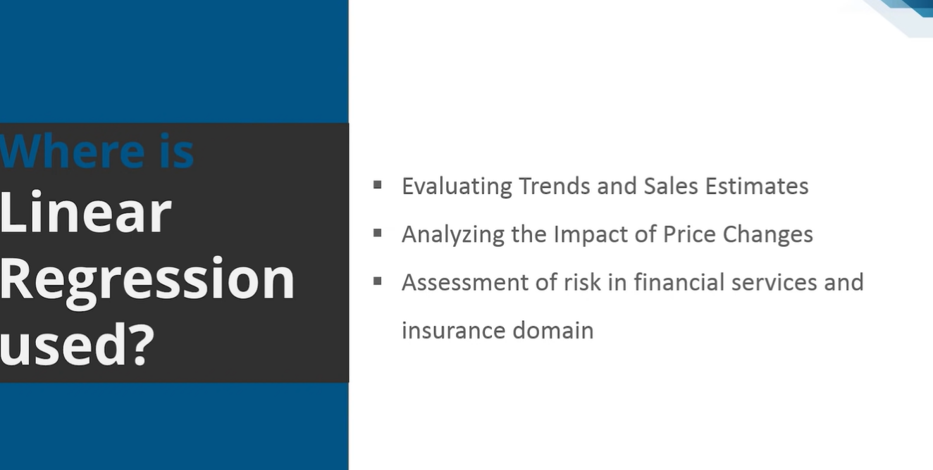

Slide 67
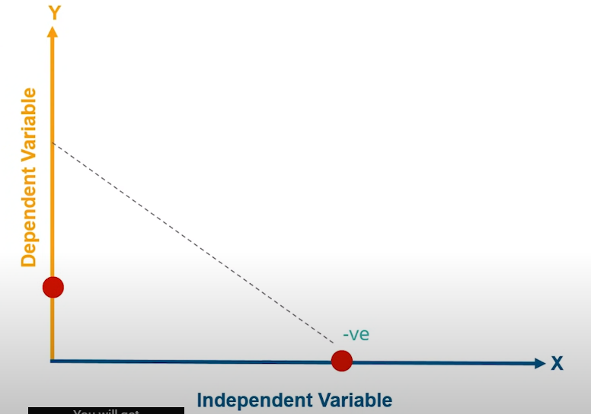
Understanding linear regression algorithm

Slide 68
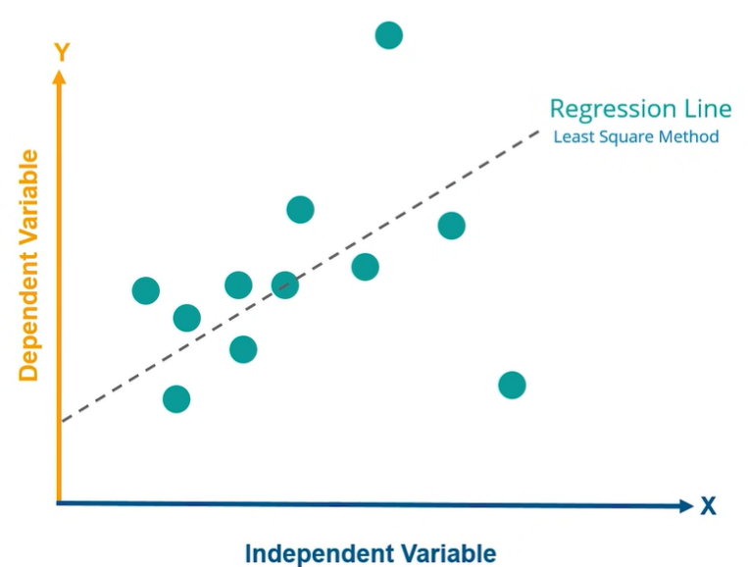

Slide 69
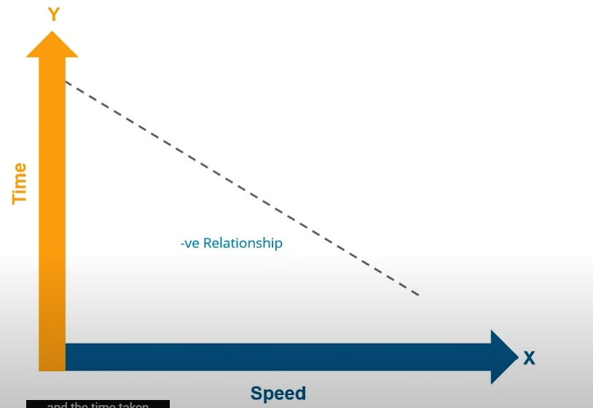
Y = -mx + c
In this case, time remains constant. ‘y’ represents the distance traveled in a fixed duration of time. X is the speed of the vehicle ‘m’ is the positive slope of the line and c is the intercept of the line.
In this case, the time taken to travel a fixed distance (y) gives the line with a negative slope. ‘x’ is the speed of the vehicle. ‘m’ is the negative slope of the line and intercept of the line.

Slide 70
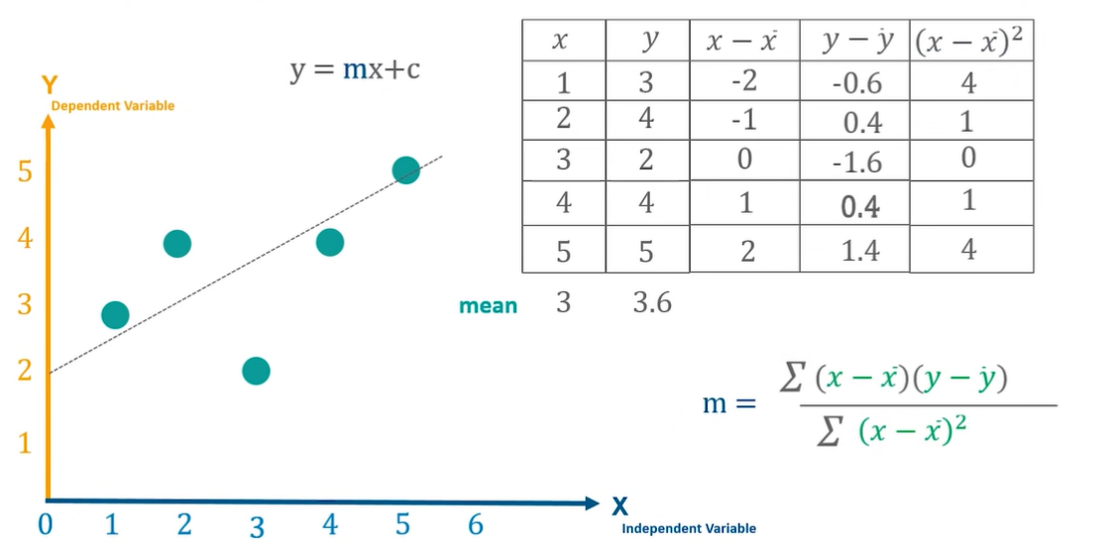
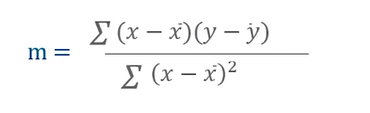

Slide 71
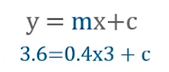
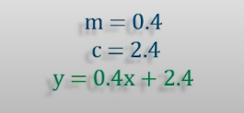

Slide 73
The task here is to reduce the distance between the actual and the predicted value. The line passing through all the calculated points and cutting y at 2.4 is the LINE OF LINEAR REGRESSION.

Slide 74
Now our task is to reduce the distance between the actual and the predicted value i.e., to reduce the error between the actual and predicted value. The line with the least error will be the line of linear regression.
This is how things work inside the system. The system performs ‘n’ number of iterations for different values of ‘m’. For different values of ‘m’ it will calculate the equation of line where y=mx+c.
Thus, as the value of ‘m’ changes the line is changing. The iteration will start from 1 and the ‘n’ number of iterations will be performed. After every iteration, the predicted value is calculated according to the line and compare the distance of the actual value to the predicted value. The value of ‘m’ for which the distance between the actual and predicted value is minimum is selected as the best-fit line.

Slide 75
HOW GOOD OUR MODEL IS PERFORMING?

Slide 79
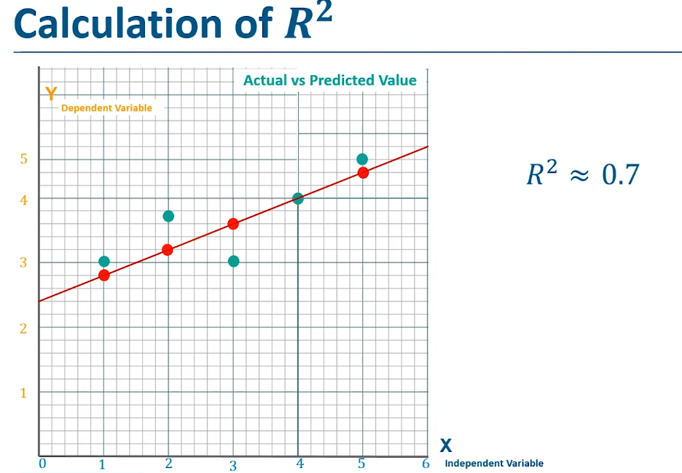

Slide 84
It is a decision tree problem so it has taken a majority vote and if were a regression problem it would have taken the mean of it.
The concept of random forest is based on the decision tree.

Slide 85
The entire dataset is fed at the root node
Decisions are being taken and splitting is performed
Predictions are made

Slide 87
Body Mass
The Dataset consists of Bill, the flipper and the body mass of the penguin.

Slide 88
This is a simple decision tree, so the depth of the tree is less. If this would have been a decision tree with many levels, then this could have led to overfitting of data. This is one of the drawbacks of the decision tree that random forest overcomes

Slide 91
Bootstrap datasets

Slide 92
We take the smaller part of the dataset in random sampling. In the above example, we have selected 6 rows (randomly selected) and four columns or features.
There are three subsets created from the selected dataset. These three will become the decision trees.
In the subsets, the random rows have been selected and features have been selected (feature selection).
Replacement basically implies that the rows selected in one subset can be repeated in the other subset as well. This means that the random forest can use rows multiple times with multiple decision trees.
When we work with smaller subsets of datasets that have been selected these are called BOOTSTRAP DATASETS.
When we aggregate the results of the bootstrap datasets then it is called as BOOTSTRAP AGGREGATION.

